Slide 1
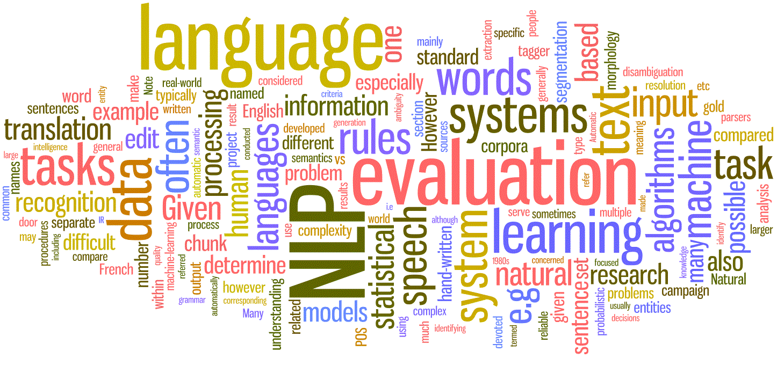

Introduction to Natural Language Processing
Sumit Sengupta
Cloud Solution Architect
Microsoft
Jan 11, 2018
Cleveland AI Meetup Group

Slide 2
Agenda
What is NLP ( Text versus Speech )
History and Early Uses
Applications of NLP
Use cases for Social Media
NLP Using Cloud tools
NLP Using Python and NLTK
Notes:
Machine learning is the intersection between theoretically sound computer science and practically noisy data. Essentially, it’s about machines making sense out of data in much the same way that humans do. Machine learning is a type of artificial intelligence whereby an algorithm or method extracts patterns from data
Supervised learning, or function approximation, is simply fitting data to a function of any variety.
Unsupervised learning involves figuring out what makes the data special. For instance, if we were given many data points, we could group them by similarity or perhaps determine which variables are better than others.
Reinforcement learning involves figuring out how to play a multistage game with rewards A common example of a reinforcement learning algorithm is a mouse trying to find cheese in a maze. For the most part, the mouse gets zero reward until it finally finds the cheese.

Slide 3
What is NLP
Analyze, Understand, Derive, Express Human Languages
Using Machine Learning to find insights and relationships in text
Language Detection
Information Retrieval and Extraction
Information Summarization
Sentiment Analysis ( scrape Facebook/Twitter comments )
Voice Recognition, Voice activated programs/devices
Machine Translation ( e.g. Skype live chats/calls or Facebook postings )
Detect malicious attacks like phishing or spam emails
Notes:
Information extraction – from a body of email – or from the AWS example later, it knows what is a date, what is a place, activity, time etc.

Slide 4
History of NLP
Three Psychologists at UC Santa Cruz
Richard Bandler, Frank Pucelik and Prof John Grinder
Analyzed the work of Virginia Satir ( mother of family therapy )and Fritz Perls- father of “Gestalt Therapy”
Studied the language structure of the therapies. What worked ?
Bandler and Grinder studied other great communications
Widely regarded as start of NLP, this is anecdotal..
Notes:
Richard Bandler enrolled as a young 20-year old psychology student in the UC Santa Cruz in 1970. Frank Pucelik worked with Bandler and then they were joined by John Grinder. Grinder, a young associate professor of linguistics at the university .
Soon they were applying Grinder's linguistic skills and Bandler's creative genius to analyze the work and the success-rate of Virginia Satir (mother of Family Therapy) and Fritz Perls (founder of Gestalt Therapy).

Slide 5


NLP Tasks
Tokenization
Breaking text into sentences and then to words. Breaking words into parts of speech ( Noun, verbs etc ).
Stemming and Lemmatization
Breaking words to its roots ( am, are, was, is → to be ) and is in addition, knowing the context – root plus its meaning, parts of speech etc.
Classification
Assign one or more categories to a document. Useful for news sites, blogs, content management sites.
Search Engine Optimization
Segmentation – words, phrases, sentences, ideas
What is a sentence marker ? “?/!” “.” can be Ms./Inc. or e.g. or end of sentence or 0.34
Difficult task
Multiple meaning of the same word. ( “address” / “tire” – in Chinese homonyms have different spelling - 沉默 VS 沉没 )
Ambiguous headlines – “Hospitals are sued by 7 foot doctors” or “Teacher strikes idle kids”
Question/Answer – how effective is this medicine in treating this symptom ? – this video shows detecting cancer using NLP Classified, 2017
Summarization of a news or blog article
Creating a complete bot – that can answer all questions

Slide 6
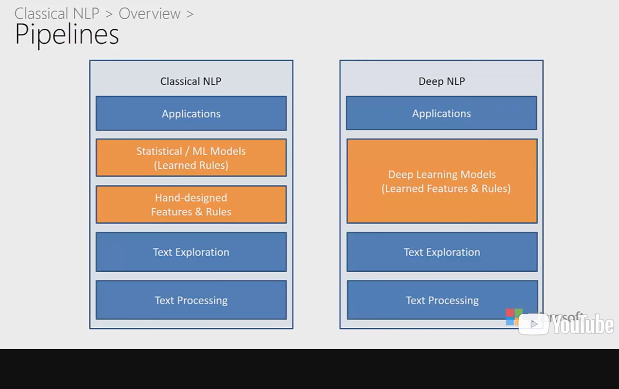
Classical versus Deep

Slide 7
Applications for Social Media
Navigating
Information Retrieval and Extraction
Information Summarization
Filtering Understand Human Behavior
Rumor Detection
Adult Content Filtering
Characterizing
Trending Topic Detection
Sentiment Detection
Capture tweets in obsolete languages !

Slide 8
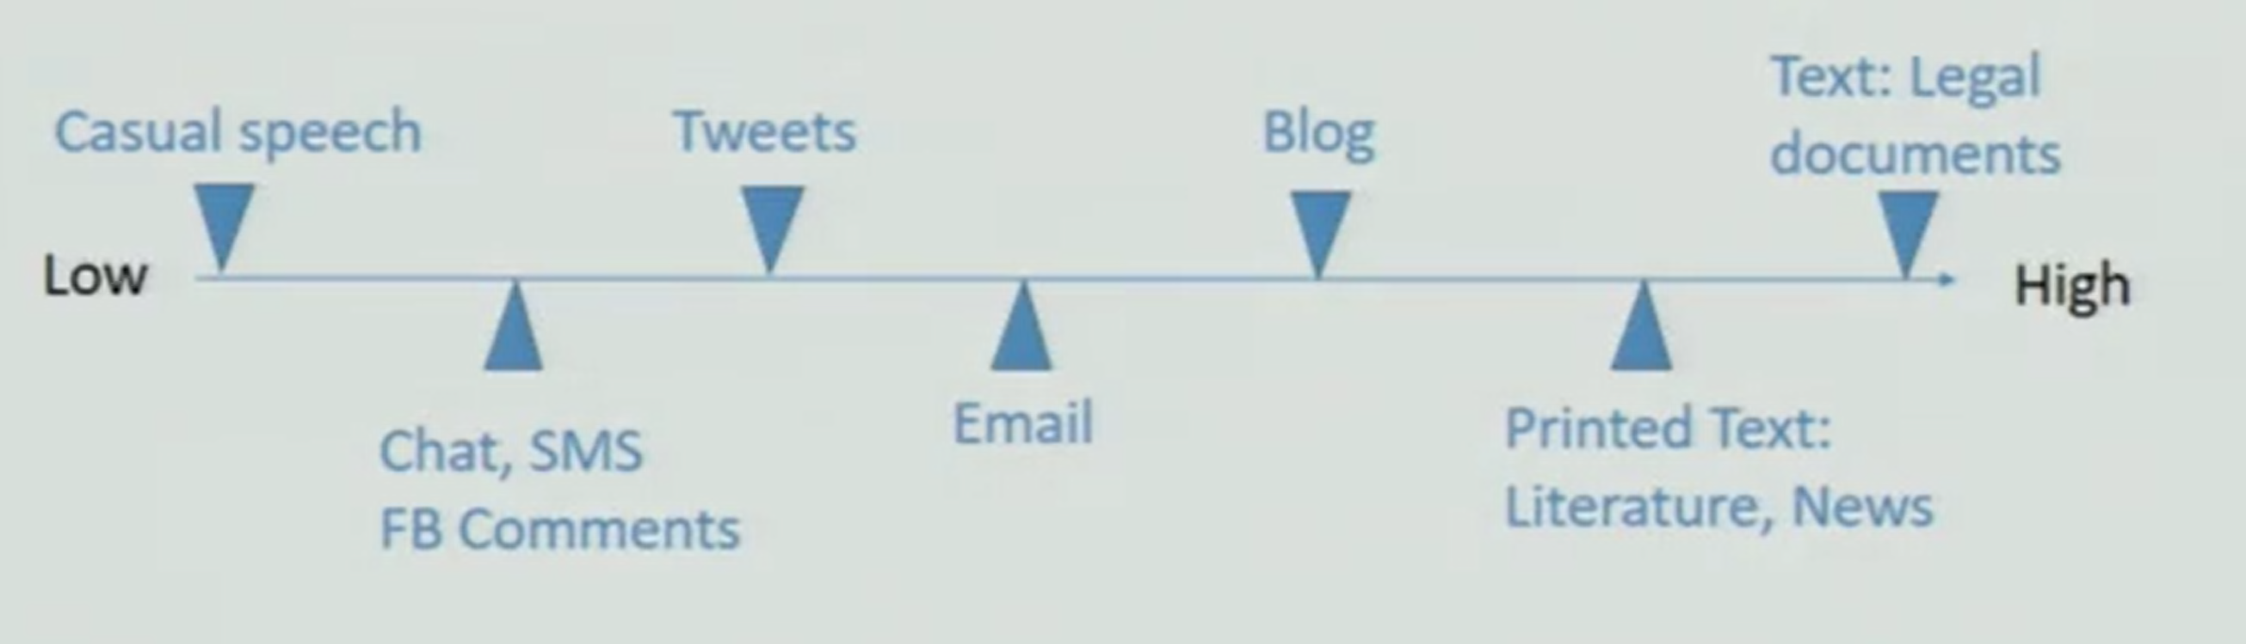
Challenges in Social Media
Traditional NLP is designed for languages that are
Single language, Grammatically correct
No spelling errors, Written in correct script
Emoticons ☺ , #hashtags, abbreviations
Colloquial languages
Slangs, non-dictionary words, Mix of languages e.g. bi-lingual written in Roman Script
In ‘Formality Spectrum’ below →

Slide 9
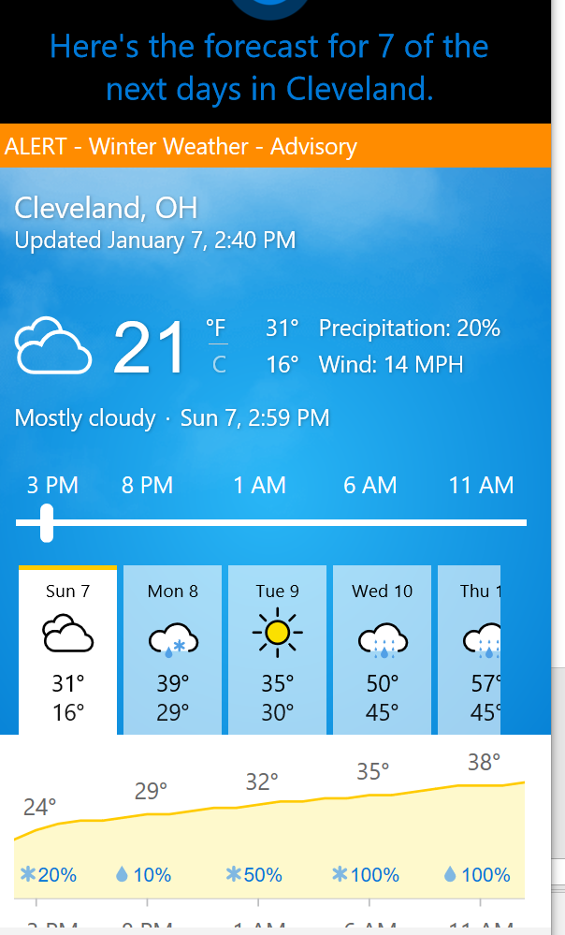
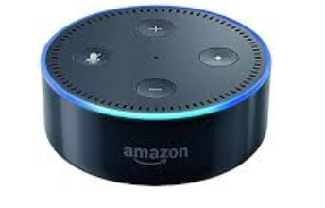
Cloud enabled uses of NLP
Apple’s Siri / Ok Google / Microsoft Cortana
What’s the weather in Cleveland this week ?
Speech Recognition, Web Search, Voice Response
Amazon’s Alexa
Alexa what is the news flash today ?
Alexa play music from Pandora
Even – can you tell a joke ?
IBM Watson
Won jeopardy 2/6/2011

Slide 10
More NLP uses
Online Language Translator
Automatic detection of language ( in many scripts ) Google or Microsoft
Speech Recognition, Web Search, Voice Response
Voice activated computer
Speak your commands instead of using keyboard and mouse
In Windows 10 search -> Windows Speech Recognition
In Mac System Preference –> Keyboard – Dictation

Slide 11

NLP Demo

Slide 12
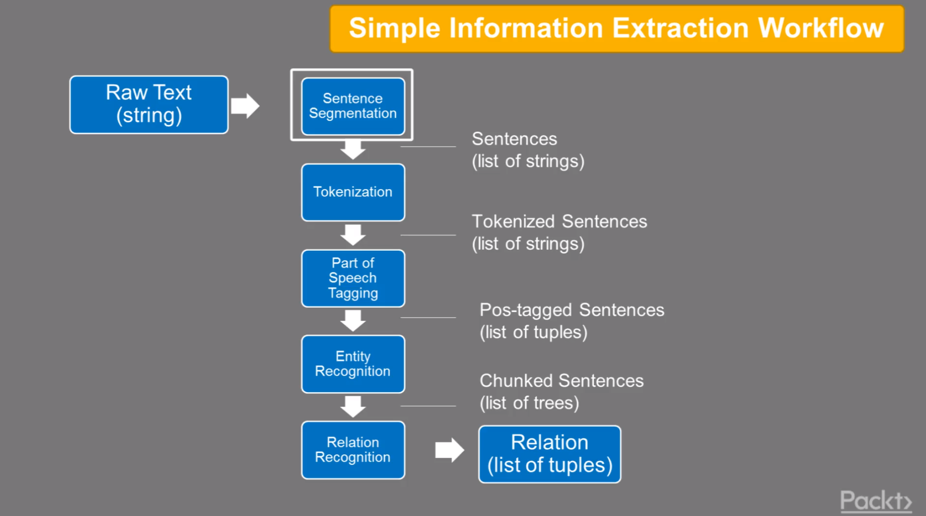
Typical Python / NLTK Workflow

Slide 13
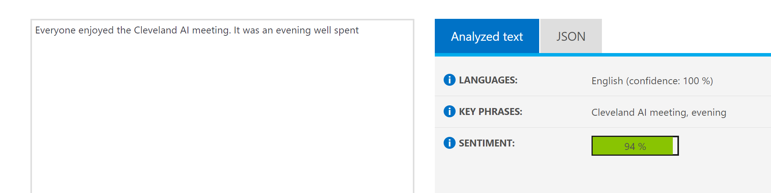
Cloud – Azure Text Analytics API
Language Detection ( 17+ languages in demo site )
Sentiment Analysis
Key Phrase Detection
Demo site – https://azure.microsoft.com/en-us/services/cognitive-services/text-analytics/
Use through Azure Cognitive Services ( 120 languages including scripts )

Slide 14
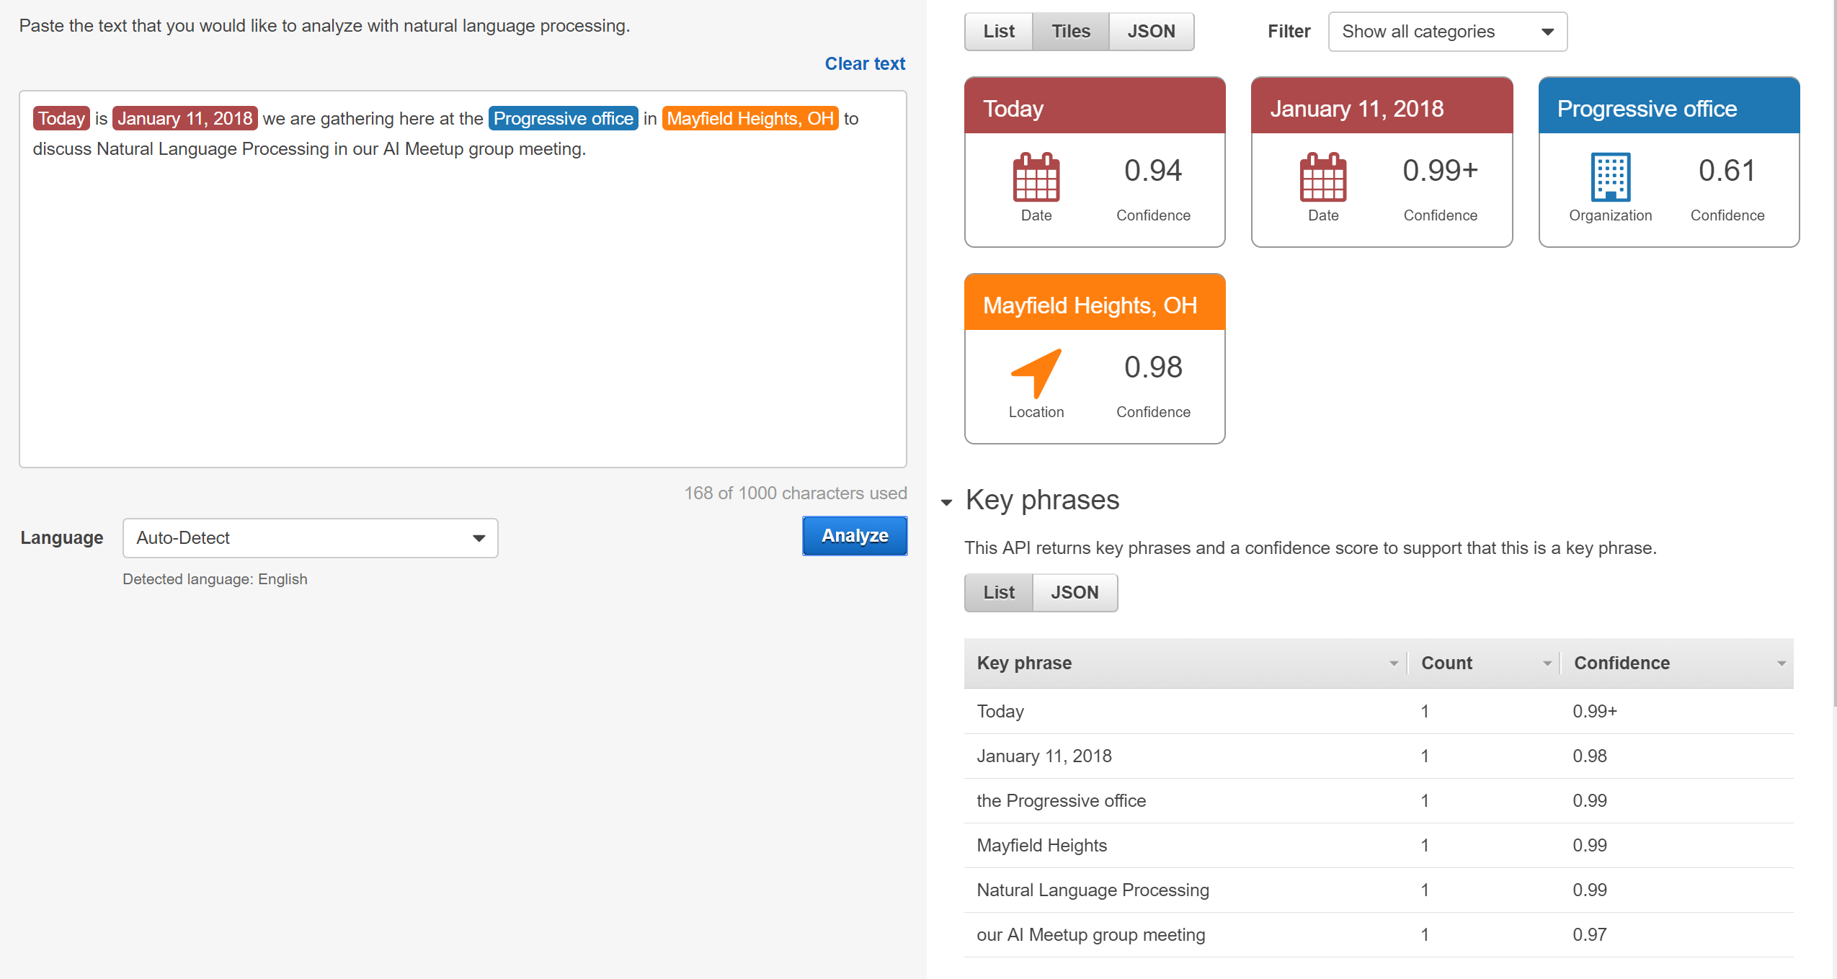
Cloud – AWS Comprehend

Slide 15
NLP Using Python NLTK
NLTK library for NLP tasks in Python
Easier Install Using Anaconda distribution ( Python 3.6, Jupyter Notebook, NLTK )
Also can be installed separately – www.nltk.org if you want to run on your own Python environment outside of Anaconda
Concordance function like grep - text1.concordance ( ‘happy’ ) all lines with ‘happy’
Notes:
Over 150 packages in anaconda for python 3.6 distribution

Slide 16
Resources
Book - https://www.safaribooksonline.com/library/view/emerging-applications-of/9781466621695/
https://www.safaribooksonline.com/library/view/applied-natural-language/9781609607418/
Channe l 9 video – Early detection of cancer using NLP classifiers analyzing medical journals - https://channel9.msdn.com/events/Build/2017/T6991?term=nlp or article – http://aka.ms/relation_extraction
NLP for Document processing –link
Intro blog - https://blog.algorithmia.com/introduction-natural-language-processing-nlp/
History - https://www.linkedin.com/pulse/short-history-nlp-neuro-linguistic-programming-chris-adlam/
Oreilly Online course – Natural Language Processing with Python by Tyler Edwards
Introduction to NLP - https://www.youtube.com/watch?v=nfoudtpBV68&list=PL6397E4B26D00A269&index=1

Slide 17

Thank You !
Questions ?
Sumit Sengupta
Sumit.Sengupta@Microsoft.com

